Slide 1

New Horizon Institute of Technology and
Management, Thane
Department of computer engineering
Fake news Detection Using machine learning
By Arun borale IEN No.11722001
By Vishal Singh IEN No.11722015
By Hritik Madke IEN No.11722010
Guided by Prof. Mamta Patil

Slide 2

Problem Statement
  Develop a machine learning Application to identify fake/unreliable news based on text content acquired
Fake news detection using machine learning

Slide 3
Architecture
Ìmport datset
start
Removing punctuation(regex)
tokenization
Removing
Stopwor
-ds
Splittin-g of dataset
Count vectorizer and tf-idf vector
lemmatization
Test data
Train data
Machine learning algorithm(logistic regression)
Deployment
accuracy
result
Prediction
Input text
Fake news detection using machine learning

Slide 4
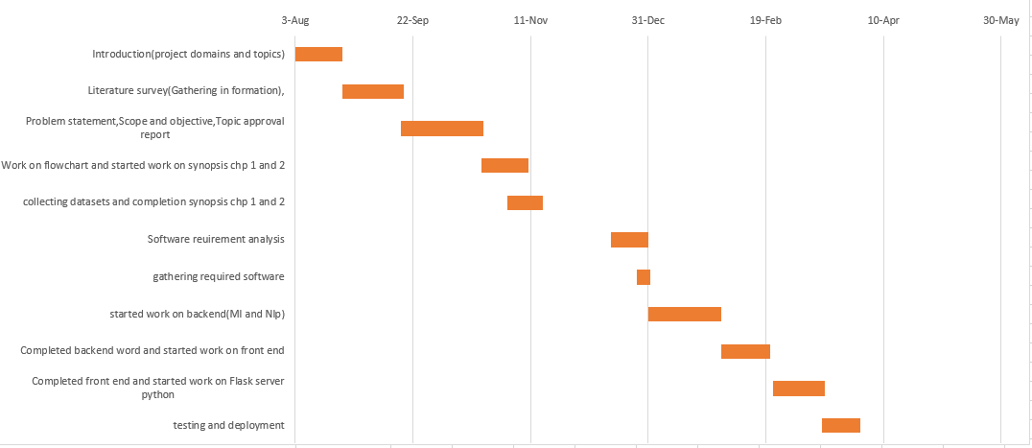
Implementation Plan
Gantt chart
3-23 august
23 aug-17 sep
17 sep-21 oct
21 oct-31 oct
1-15 nov
15 dec-31 dec
31 dec-7 jan
7 jan -13 feb
14 feb- 22 feb
22 feb- 15 march
15 march-31 march
Fake news detection Using Machine Learning

Slide 5
Data Preprocessing
Functionalities: Data is clean and reduce by size using data pre-processing operation like stopwords removal,
lemmatization, stemming using nltk .
Input Given:
Title
Author
Text
Result Obtained: More clean and processed data obtained by removing unwanted words.
Fake news detection using machine learning

Slide 6
Splitting of dataset
Functionalities: Data is split into train and test set format by using train-test-split technique in 70:30 ratio for machine
learning algorithm implementation and further comparison with predictive model dataset
Input Given:
Title
Author
Text
Result Obtained: Dataset is splitted successfully into required ratio .
Fake news detection using machine learning

Slide 7
Data Formatting
Functionalities: Data is change into desired numeric format by using tf-idf vectorizer and bags of words technique using
td-idf
Input Given:
Title
Author
Text
Result Obtained: Text data is successfully converted into desired numeric format each word is given numeric value
according to weightage or how many time they appeared in sentence.
Fake news detection using machine learning

Slide 8
Modelling
Functionalities: Machine learning model is applied to the splitted dataset and train set data is fitted in to machine
learning classifier to train the model.
Input Given:
Title
Author
Text
Result Obtained: Model is trained successfully.
Fake news detection using machine learning

Slide 9
Prediction
Functionalities: To check whether model is giving required result or not by passing data from train
dataset
Input Given:
Title
Author
Text
Result Obtained: Model is predicting properly and giving true output in almost all the input passed.
Fake news detection using machine learning

Slide 10
Pending Modules
Proper dataset collection, Front end and flask server work will be completed by 15th march 2021.
Deployment will be completed by 31th March 2021.
Fake news detection using machine learning

